Slide 1

Narrative AI Generation
By Isaac Dunn

Slide 2
Introduction
What is narrative AI
Types of narrative AI
How games use narrative AI

Slide 3
Introduction –Types of narrative AI
Procedural generation
Emergent generation

Slide 4
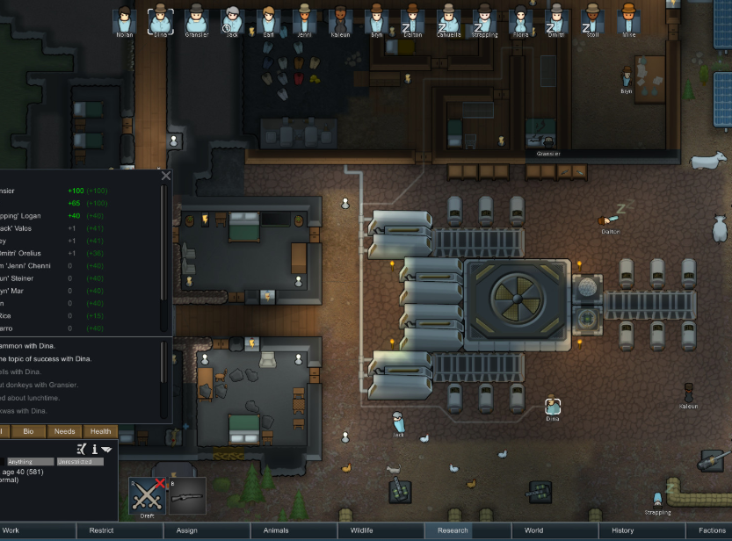

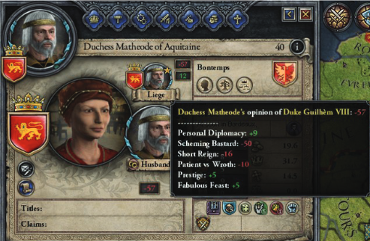
Introduction –How its used
Traits
Dialog
Responsive AI

Slide 5
Aims and objectives
Aim to create a narrative AI with a cast character
Characters are able to talk to each other
Have actions and goals
Personality and emotion ai

Slide 6
Background
Why this project was chosen
Why it is important in games

Slide 7
Research methodology
Consider Waterfall vs Scrum
Scrum implementation

Slide 8
Project plan
Time scale (October – April)
Gantt chart

Slide 9
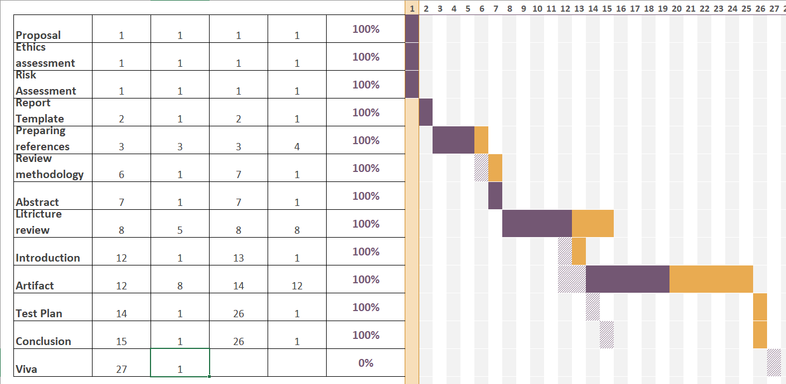
Project plan – Gantt

Slide 10

Analysis
C#
Unity

Slide 11
Implementation
Narrative Scaffolding
Natural Language Processing
Emotional AI
Personality System

Slide 12
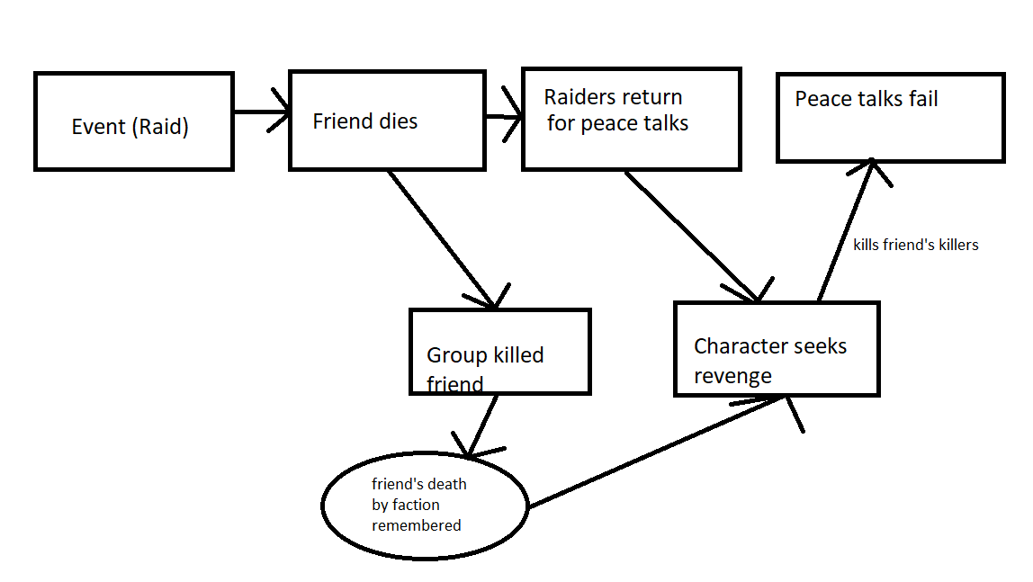
Implementation – Narrative Scaffolding
Event/ memory system
Time frame
Precondition
Interaction/ plot progression

Slide 13
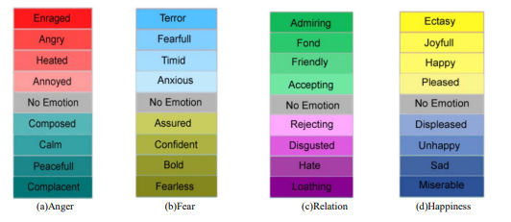
Implementation – Emotional AI
Heuristic (anger, relation, happiness)
Mental break system

Slide 14
Implementation - NLP
Neural Networks (GTP-2)
Neural Networks (sentiment analysis)
Basic text manipulation with personality system

Slide 15
Implementation – Personality system
Traits
Reactions

Slide 16
Testing
Test Log
Evaluation

Slide 17
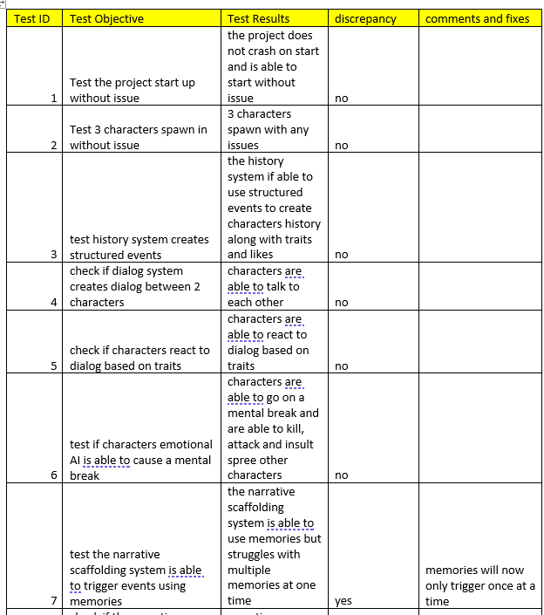
Testing – Test Log

Slide 18
Testing – Evaluation
Comparison of system to other games
Whether the system was able to create a whole story

Slide 19
Results
Issues from test log
Issues with the project

Slide 20
Demo
Youtube link or game

Slide 21
Conclusion
What went well
What did not
What could be improved

Slide 22
Bibliography
(n.d.). Retrieved from https://monkeylearn.com/sentiment-analysis/
Alec Radford, J. W. (2019, 2 14). Better Language Models. Retrieved from OpenAI: https://openai.com/blog/better-language-models/#sample3
Alvim, L. G., & Cruz, A. J. (2008, 6 6). A Fuzzy State Machine applied to an emotion model for electronic game characters. Retrieved from IEEE explore: https://ieeexplore.ieee.org/document/4630637
Anurag Sarkar, S. C. (2021, 10 8). Procedural Content Generation using Behavior Trees. Retrieved from arxiv: https://arxiv.org/pdf/2107.06638.pdf
Bay12Games. (2021, 12 1). Dwarf Fortress. Retrieved from Bay12Games: http://www.bay12games.com/dwarves/
Deutsch, M. (2016, 7 8). Harry Potter: Written by Artificial Intelligence. Retrieved from Medium: https://medium.com/deep-writing/harry-potter-written-by-artificial-intelligence-8a9431803da6
Emily Sheng, K.-W. C. (2019, 10 23). The Woman Worked as a Babysitter: On Biases in Language Generation. Retrieved from Arxiv: https://arxiv.org/pdf/1909.01326.pdf
Feldman, R. (2013, 04 1). Techniques and Applications for Sentiment Analysis. Retrieved from dl.acm.org: https://dl.acm.org/doi/pdf/10.1145/2436256.2436274
Francesco Mondada, M. B.-A. (2017, 10 27). Finite State Machines. Retrieved from SpringerLink: https://link.springer.com/chapter/10.1007/978-3-319-62533-1_4
Garbe, J. (2018, 2 18). Simulation of History and Recursive Narrative Scaffolding. Retrieved from Delve: http://project.jacobgarbe.com/simulation-of-history-and-recursive-narrative-scaffolding/

Slide 23
Bibliography
Hudson, L. (2016, 9 28). Some Like It Bot. Retrieved from FiveThirtyEight: https://fivethirtyeight.com/features/some-like-it-bot/
Humphreys, T. (2021, 12 1). Chapter 12 Exploring HTN Planners. Retrieved from gameaipro: https://www.gameaipro.com/GameAIPro/GameAIPro_Chapter12_Exploring_HTN_Planners_through_Example.pdf
IBM. (2020, 7 2). Natural Language Processing (NLP). Retrieved from IBM: https://www.ibm.com/cloud/learn/natural-language-processing
Igor Ribeiro Lima, T. d. (2012, 1 1). Adapting and Using Scrum in a Software . Retrieved from fsma.edu.br: http://fsma.edu.br/si/edicao9/FSMA_SI_2012_1_Principal_2_en.pdf
Ilche Georgievski, M. A. (2014, 3 28). An Overview of Hierarchical Task Network Planning. Retrieved from Arxiv: https://arxiv.org/pdf/1403.7426.pdf
Jason Grinblat, C. B. (2017, 8 14). Subverting historical cause & effect: generation of mythic biographies in Caves of Qud. Retrieved from ACM: https://dl.acm.org/doi/pdf/10.1145/3102071.3110574
JSON.org. (2022, 5 4). Introducing JSON. Retrieved from JSON.org: https://www.json.org/json-en.html
Kaushal Chari, M. A. (2017, 4 22). Impact of incorrect and new requirements on waterfall software project outcomes. Retrieved from Research Gate: https://www.researchgate.net/publication/316362583_Impact_of_incorrect_and_new_requirements_on_waterfall_software_project_outcomes
Khalil, M. A., & Kotaiah, B. (2017, 8 1). Implementation of agile methodology based on SCRUM tool. Retrieved from IEEE Xplore: https://ieeexplore.ieee.org/abstract/document/8389872
Latitude. (2022, 1 1). AI Dungeon. Retrieved from AI Dungeon: https://play.aidungeon.io/
Li, L., & Campbell, J. (2010, 1 1). Emotion Modeling and Interaction of NPCS in Virtual Simulation and Games. Retrieved from International Journal of Virtual Reality: https://ijvr.eu/article/view/2784/8842

Slide 24
Bibliography
Ludeon Studios. (2018, 10 17). Rimworld. Retrieved from Steam: https://store.steampowered.com/app/294100/RimWorld/
M. Mahalakshmi, D. M. (2013, 6 6). Traditional SDLC Vs Scrum Methodology – A Comparative . Retrieved from citeseerx: https://citeseerx.ist.psu.edu/viewdoc/download?doi=10.1.1.413.2992&rep=rep1&type=pdf
Marc Cavazza, F. C. (2003, 1 1). Interactive storytelling: from AI experiment to new media. Retrieved from ResearchGate: https://www.researchgate.net/profile/Marc-Cavazza/publication/220851669_Interactive_storytelling_from_AI_experiment_to_new_media/links/580f3d0308aef2ef97afbf4b/Interactive-storytelling-from-AI-experiment-to-new-media.pdf
Marchesi, M., Mannaro, K., Uras, S., & Locci, M. F. (2007, 6 22). Distributed Scrum in Research Project Management. Retrieved from ResearchGate: https://www.researchgate.net/publication/221592443_Distributed_Scrum_in_Research_Project_Management
Max Kreminski, M. D.-F. (2020, 1 1). Why Are We Like This?: Exploring Writing Mechanics for an AI-Augmented Storytelling Game. Retrieved from ucsc.edu: https://stars.library.ucf.edu/cgi/viewcontent.cgi?article=1160&context=elo2020
Scrum.org. (2022, 5 4). WHAT IS SCRUM? Retrieved from scrum.org: https://www.scrum.org/resources/what-is-scrum
Sheetal Sharma, D. S. (2012, 5 5). Agile Processes and Methodologies: A . Retrieved from yashada: Microsoft Word - IJCSE12-04-05-186.doc (yashada.org)
Short, T. X. (2021, 06 26). Designing Stronger AI Personalities. Retrieved from AAAI: https://ojs.aaai.org/index.php/AIIDE/article/view/12973
Simpson, C. (2014, 7 18). Behavior trees for AI: How they work. Retrieved from GameDeveloper: https://www.gamedeveloper.com/programming/behavior-trees-for-ai-how-they-work
Sundin, O. (2019, 10 26). Natural Language Content Generation for Computer. Retrieved from diva portal.org: https://www.diva-portal.org/smash/get/diva2:1369106/FULLTEXT01.pdf
Swanstrom, R. (2015, 05 1). Scoring a Software Development Organization with a single number. Retrieved from Research Gate: https://www.researchgate.net/figure/Modern-Waterfall-Diagram-adapted-from-36_fig2_306446532
Vincent, J. (2020, 7 30). OPENAI’S LATEST BREAKTHROUGH IS ASTONISHINGLY POWERFUL, BUT STILL FIGHTING ITS FLAWS. Retrieved from The Verge: https://www.theverge.com/21346343/gpt-3-explainer-openai-examples-errors-agi-potential

